Slide 1
Freshmen Presentation

Slide 2
Graduation Requirements:
Students can review their career plans in Skyward and counselors will advise and assist during course selection.
You must have 6 credits or more to be a sophomore. If do not, you will be reclassified as a 9th grader. You will need to see your counselor for credit alternative options- Night School, Summer School, Credit By Exam
Students will be required to stay in their chosen endorsements throughout high school
The only opportunity students will have to change their endorsement pathway will be in 10th grade. Students will have to double up on the course in the new pathway – this does not apply to Engineering or Computer Science due to the pre-reqs
It is a state requirement that all students are College and Career Ready.
What does College and Career Readiness mean…

Slide 3
College Career & Military Readiness:

Slide 4
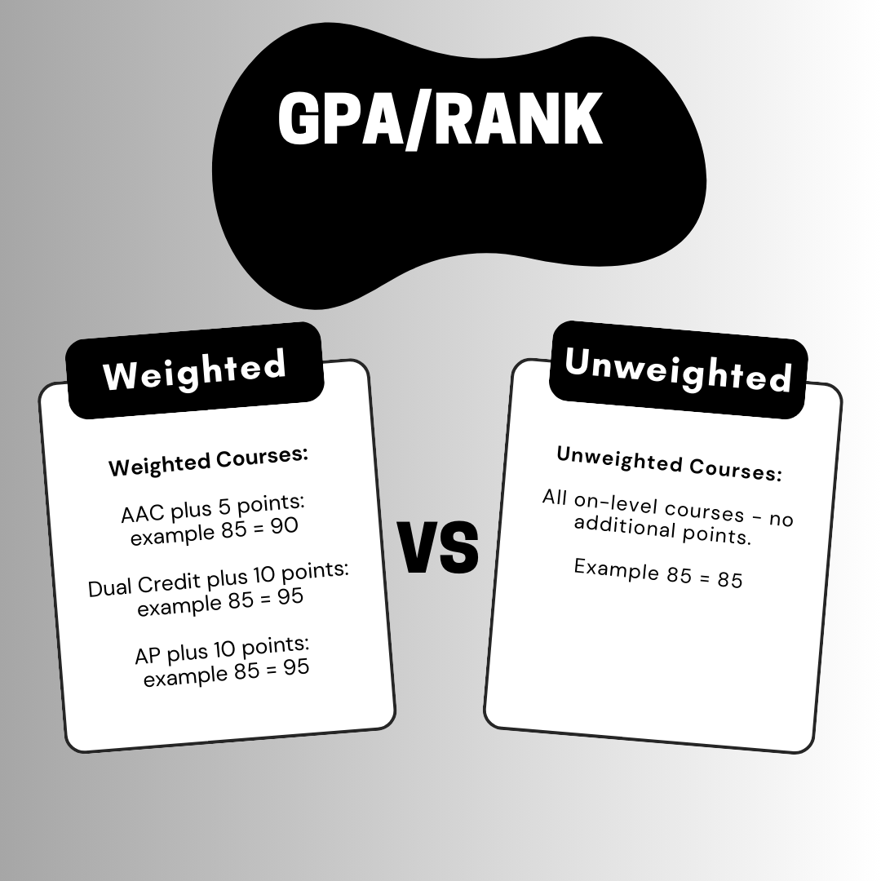
Freshmen year is the most important year. It sets the foundation of your GPA/Rank.
GPA/Rank is calculated by semester
What is a weighted or unweighted course?

Slide 5
Sample 10th Grade Student in Good Standing

Slide 6
Sample Off Track "10th Grade" Student

Slide 7
Sample 10th Grade Student STAAR Exam Results and Endorsement Status

Slide 8
Attendance counts!
Remember you can lose credit if you are absent 8 or more times – even if you have a passing grade!
If you need to make up hours due to attendance, be sure to do it. You want to start Senior year in a good position and not have to worry about recovering credits lost because of attendance.

Slide 9
Logging in to Schoolinks
1Link
Clever
Schoolinks
This Photo by Unknown author is licensed under CC BY.

Slide 10
Self-Assessment
In Schoolinks
Complete your onboarding if you have not already done so.
Go under the home icon on the left side toolbar-Click on dashboard
Click on Show Remaining To Do’s – this will pull up your assessments. You will:
Click on Create SMART Goals and add your SMART Goal about something related to your academics for 9th grade year. Once you add your goal, mark as complete.

Slide 11
988 Crisis Line

Slide 12
Join EHS Counselor & College and Career Readiness Schoology Course........
7NPB-W4H5-RVN29

